Slide 1
NODE.JS
(The Backend Of MERN Stack)
Lecture 18

Slide 2
Today’s Agenda
Defining Route Methods In Express
Handling GET Request
Sending HTML File
Exercises
Route Parameters
Query String
Which To Use When ?

Slide 3
Defining routing methods
We define routing methods in Express using following syntax:
app.METHOD(PATH,CALLBACK)
This code tells the server, “If a user generates an HTTPMETHOD request and navigates to PATH, then perform the following CALLBACK function .”

Slide 4
Defining routing methods
As expected the most commonly used names in place of METHOD are:
get(): To handle GET requests
post(): To handle POST requests
put(): To handle PUT requests
delete(): To handle DELETE requests

Slide 5
Exercise 36
WA Server to handle the GET requests for “/”, “/contact” and “/about” route.
Route | Response
/ | Hello from home route
/contact | Hello from contact route
/about | Hello from about route

Slide 6
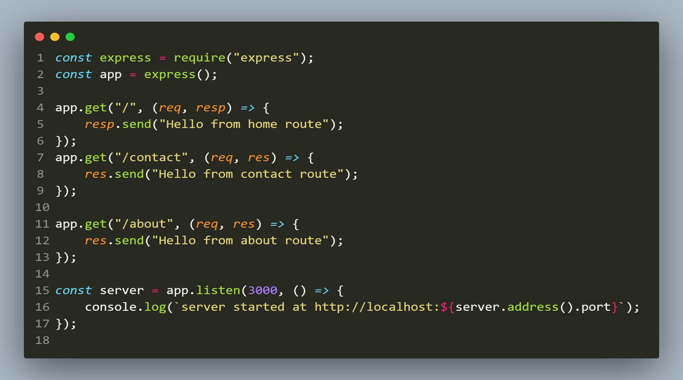
Solution
The code

Slide 7
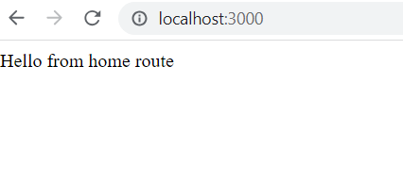
output
The output

Slide 8
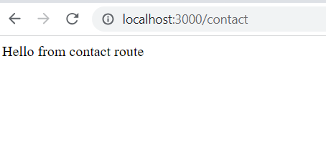
output
The output

Slide 9
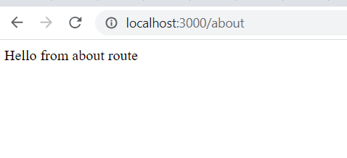
output
The output

Slide 10
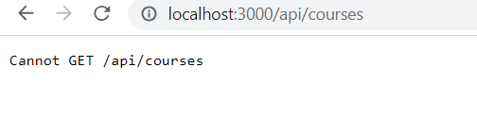
Point to remember
What if we access a route which is not present ?
Answer: In that case express will automatically return a status code of 404 with a message Cannot Get <route>

Slide 11
Serving up html file
We can send files directly from Express as a response.
These files can be of any type such as HTML, PDF, Multimedia, etc as a response to a client.
This can be done using a method called sendFile() belonging to response object

Slide 12
The sendFile() method
Syntax:
res.sendFile(filePath[, options] [, callback])
filePath: It can be an absolute path to the file or a relative path to the correct working directory, which we want to send,
options: options can be an optional argument containing various properties like root, etc,
callback: It is a function that would be called when the method has finished its execution. It accepts a single argument representing error

Slide 13
Exercise 37
WA Server to handle the requests for “/”, and return the file index.html present in a folder called public
Also make sure to return a file not found message with status code 404 in case the file is not present

Slide 14
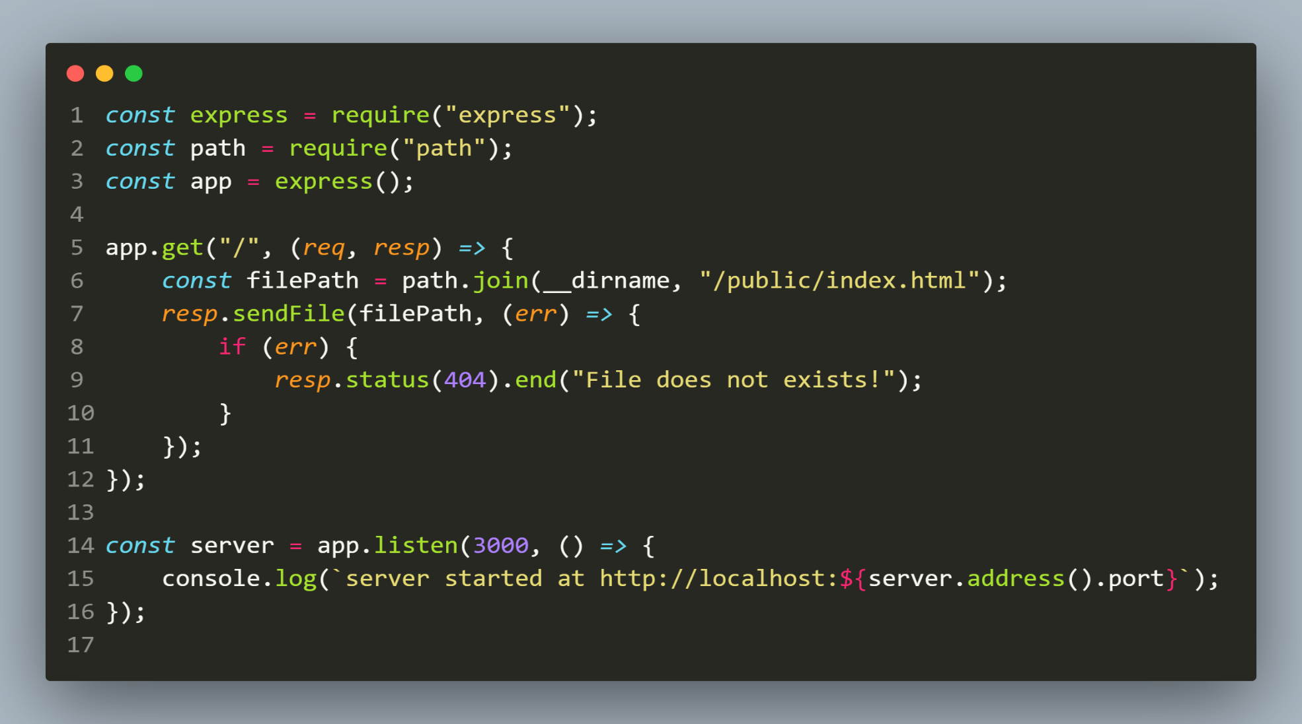
Solution
The code

Slide 15
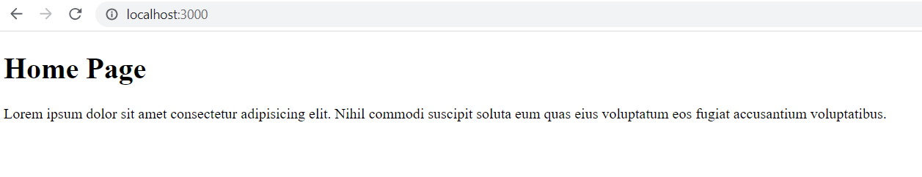
output
The output

Slide 16
Exercise 38 ( Your first restful api)
WA Server application to do the following:
Create a file called products.js containing an array holding details of 3 products :
let products = [
{ id: 101, name: “Iphone”, price: 70000 },
{ id: 102, name: “Ipad”, price: 52000 },
{ id: 103, name: “Iwatch”, price: 36000 },
];

Slide 17
Exercise 38
Now create another file called app.js and write code for handling 2 GET request:
The GET request for “/api/products” should return the full details of all 3 products
The GET request for “/api/products/list” should return only the id and name of all 3 products and not price.

Slide 18
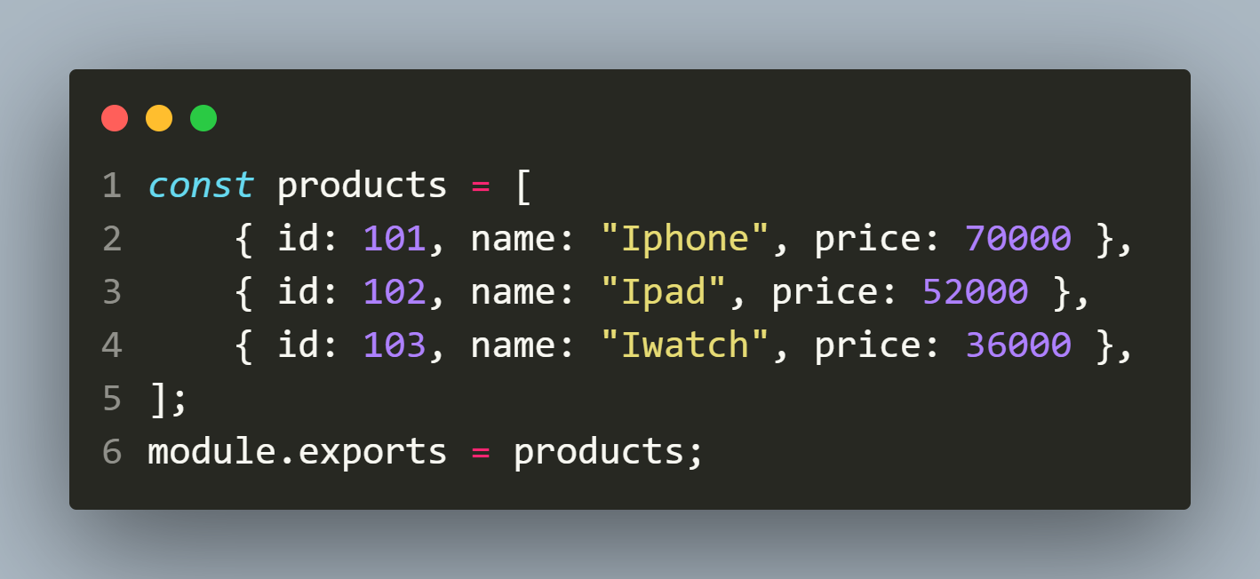
Solution
products.js

Slide 19
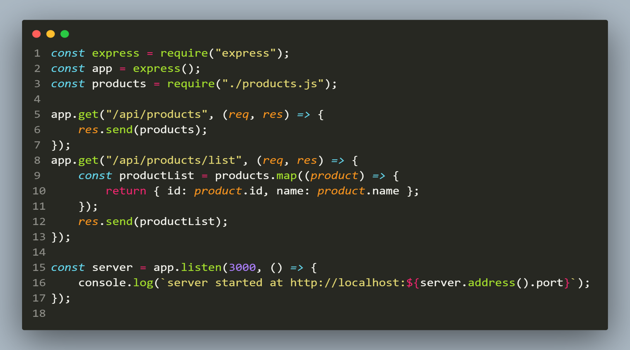
Solution
app.js

Slide 20
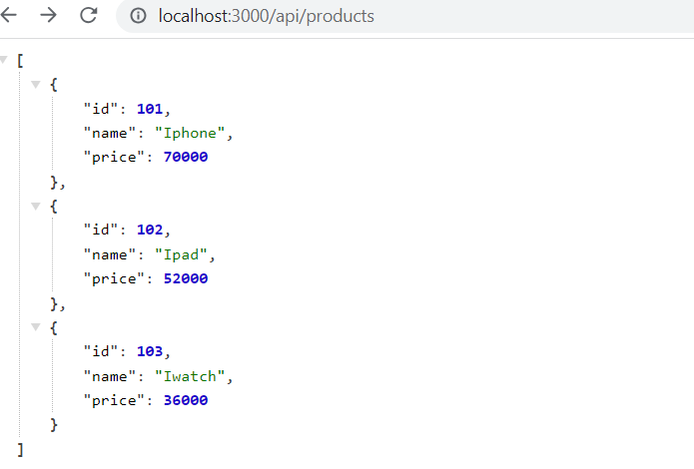
output
Requesting : localhost:3000/api/products

Slide 21
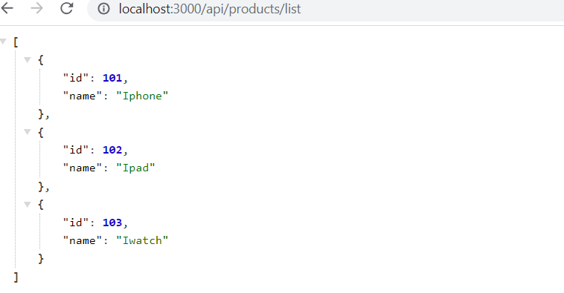
output
Requesting : localhost:3000/api/products/list

Slide 22
Question ?
In the previous example our api is returning details of all 3 products.
What if we want to return the details of a specific product only by accepting product id from client request ?

Slide 23
Question ?
There are 2 answers to the above question:
ROUTE PARAMETER
QUERY STRING
Both allow us to capture data from client request .
Let’s discuss them

Slide 24
Route parameters
Route parameters are named URL segments that are used to capture the values specified at their position in the URL.
The captured values are populated in a special object called req.params .
The keys in this object will be names of route parameters specified in the path.

Slide 25
Route parameters
Example 1:
Route path: /users/:userId
Request URL: http://example.com/users/34
req.params: { "userId": "34”}
Example 2:
Route path: /users/:userId/books/:bookId
Request URL: http://example.com/users/34/books/101
req.params: { "userId": "34", "bookId": “101" }

Slide 26
How to create route parameters ?
If we want to set up the "userId" parameter in the /users route, we will have to add the parameter name in the /users route with a colon(:) symbol
When we add the parameter as /users/:userId in the route, we will be able to get the value inside that route using the req.params object.

Slide 27
How to create route parameters ?
So in our code we will write the following:
For Example 1:
app.get('/users/:userId', (req, res) => {
// code to access req.params
});
For Example 2:
app.get('/users/:userId/books/:bookId', (req, res) => {
// code to access req.params;
});

Slide 28
Exercise 39
Rewrite the previous code by adding another route which accepts productId as route parameter and returns the details of that product only.
In case productId is not available then your api should return 404 status code with the message product not found as a JSON object

Slide 29
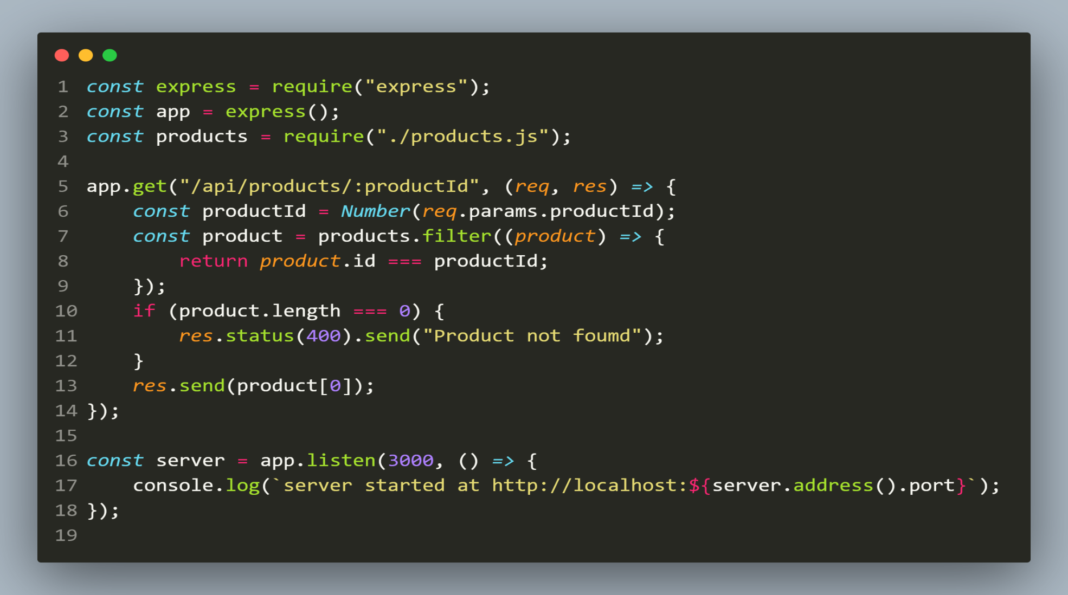
Solution
app.js

Slide 30
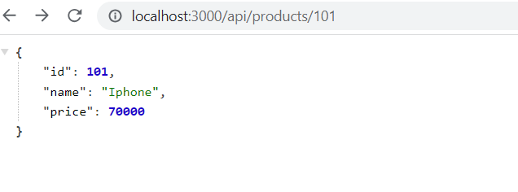
output
Requesting : localhost:3000/api/products/101

Slide 31
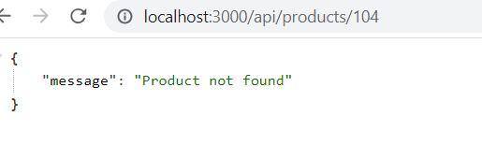
output
Requesting : localhost:3000/api/products/104

Slide 32
Query string
The query string portion of a URL is the part of the URL after the question mark ?.
For example: ?userId=34
Here userId is the key and 34 is the value

Slide 33
Query string
Each key=value pair is called a query parameter.
If our query string has multiple query parameters, they're separated by &.
For example, the below string has 2 query parameters, called userId and bookId:
?userId=34&bookId=101

Slide 34
How to obtain query parameters?
Express automatically parses the query parameters for us and stores them in the request object as query object.
So to access it we just have to use req.query .

Slide 35
Exercise 40
Rewrite the previous code by passing a query parameter called productId and return the details of that product only.
In case productId is not available then your api should return 404 status code with the message product not found as a JSON object

Slide 36
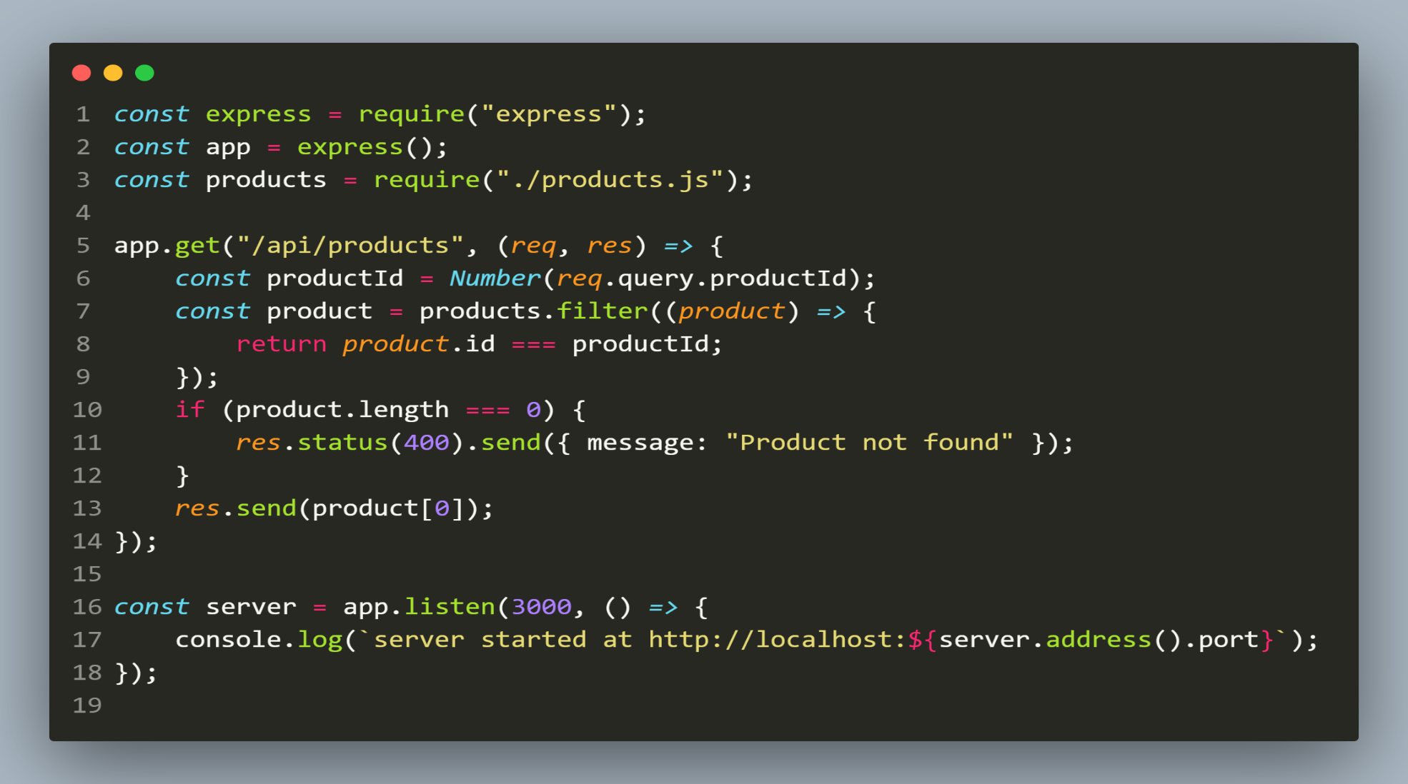
Solution
app.js

Slide 37
output
Requesting : localhost:3000/api/products/101

Slide 38
output
Requesting : localhost:3000/api/products/104

Slide 39
Route parameters v/s query string
Both, query strings and route parameters, carry information to the server through the URL and thus serve the same purpose.
But they have some differences:
We don't need to change the route path to access query strings. But for parameters, we have to add them individually in the route.
We can access as many queries as we want in the route very easily because we don't have to add them to the route path. We just add them to the URL. But it is not the case with route parameters.

Slide 40
Route parameters v/s query string
We need to add the parameter values in a specific order to the URL according to the route path. But we can put queries randomly, order doesn't matter.

Slide 41
Which to use when ?
As a best practice, it is recommended the following way:
If we want to identify a resource, we should use Route parameters .
But if we want to sort or filter items, then we should use query parameter.
For example:
/users/123 # Fetch a user who has id 123
/users?occupation=programer # Fetch a list of programers

